Slide 1

Md. Manowarul Islam
Assistant professor
Jagannath university

Slide 2
Data cleaning
Machine Learning Process Steps in Data Preprocessing
Step 1 : Import the libraries
Step 2 : Import the data-set
Step 3 : Check out the missing values
Step 4: handling the missing values
Step 5 : See the Categorical Values
Step 6 : Splitting the data-set into Training and Test Set
Step 7 : Feature Scaling

Slide 3
Data cleaning
#Check a particular column
data[‘Age’]
#Copy and create another dataframe
data1=data[['Age','Salary']]
data1

Slide 4
Data cleaning
Step 3 : Check out the missing values
  data.isnull().values.any()
  data.isnull().sum()
  data.isnull()
  data.isnull().sum().sum()

Slide 5
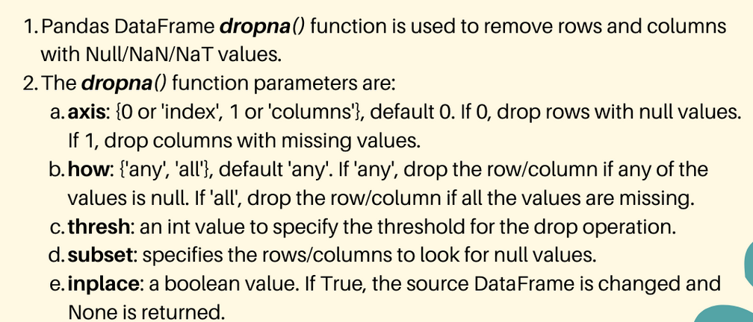
Data cleaning
Step 4: handling the missing values
  Deleting a particular row
  Deleting a particular columns
  data1= data.copy()
  dropna() will drop all rows in which any null value is present
  data3 = data.dropna(axis=1)/data.dropna(axis='columns')
  data3 = data.dropna(axis=0)/data3 = data.dropna(axis='rows')

Slide 6
Data cleaning
Step 4: handling the missing values
  mean=data1['Age'].mean()
  df_result = data.fillna(0)
  data1= data.copy()
  nfil=data1.fillna(method="ffill")
  bfil=data1.fillna(method="bfill")

Slide 7
Import the libraries/Dataset
Importing the libraries
  import numpy as np
  import pandas as pd
Reading the Dataset
  data=pd.read_csv('diabetes.csv')

Slide 8
Analysis the dataset
Show the shape
  data.shape
  data.describe()
  data.describe().T
  data.dtypes
  data.columns
  data['Pregnancies'].dtype
#Copy and create another dataframe
d1=data[['Pregnancies','Glucose']]

Slide 9
Finding missing values
Checking Missing value
  data.isnull().values.any()
  data.isnull().sum()
  data.isnull().sum().sum()
Copy original dataset
  data2=data.copy()

Slide 10
Finding missing values
Accessing individual values
  data2['Pregnancies'].head(10)
Replace 0 with nan
  data2.columns
  data2.iloc[:,0].replace(0,np.nan)
  data2.iloc[:,0].replace(0,np.nan,inplace=True)
  data2['Pregnancies'].head(10)
  data2.iloc[:,0].replace(np.nan,0,inplace=True)
df.iloc[:, 0:2] #First 2 columns

Slide 11
Data Frames: method iloc
df.iloc[0] # First row of a data frame
df.iloc[i] #(i+1)th row
df.iloc[-1] # Last row
df.iloc[:, 0] # First column
df.iloc[:, -1] # Last column
df.iloc[0:7] #First 7 rows
df.iloc[:, 0:2] #First 2 columns
df.iloc[1:3, 0:2] #Second through third rows and first 2 columns
df.iloc[[0,5], [1,3]] #1st and 6th rows and 2nd and 4th columns

Slide 12
Finding missing values
Replace 0 with nan
  data2.iloc[:,1].replace(0,np.nan,inplace=True)
  data2['Glucose'].isnull().values.any()
  data2['Glucose'].isnull().sum().sum()
  data2.iloc[:,2].replace(0,np.nan,inplace=True)
  data2['BloodPressure'].isnull().values.any()
  data2['SkinThickness'].replace(0,np.nan,inplace=True)
  data2['SkinThickness'].isnull().values.any()
  data2['SkinThickness'].isnull().sum().sum()

Slide 13
Finding missing values
Replace 0 with nan (Group of columns)
  columns=['Insulin','BMI']
  for cols in columns:
  data2[cols].replace(0,np.nan,inplace=True)
for cols in columns:
print(data2[cols].isnull().values.any())
print(data2[cols].isnull().sum().sum())

Slide 14
Finding missing values
find the mean value of Glucose value
  g_mean=data2['Glucose'].mean();
  g_mean
  data2['Glucose'].fillna(g_mean)
  data2['Glucose'].fillna(g_mean,inplace=True)
  data2['Glucose'].isnull().sum()

Slide 15
Finding missing values
Find the median value of BloodPressure value
  bp_median=data2['BloodPressure'].median()
  bp_median
  data2['BloodPressure'].fillna(bp_median, inplace=True)
  data2['BloodPressure'].isnull().sum()
  data2.isnull().sum()

Slide 16
Finding missing values
Find the mode value of Skinthickness value
  data2['SkinThickness'].value_counts()
  st_mode=data2['SkinThickness'].mode()
  St_mode
  data2['SkinThickness'].fillna(st_mode, inplace=True)
  data2.isnull().sum()
  st_mode=data2['SkinThickness'].mode()[0]
  st_mode=data2['SkinThickness'].mode()

Slide 17
Finding missing values
Find the mode value of Skinthickness value
  data2['SkinThickness'].value_counts()
  st_mode=data2['SkinThickness'].mode()[0]
  st_mode
  data2['SkinThickness'].fillna(st_mode, inplace=True)
  data2['SkinThickness'].value_counts()

Slide 18
Finding missing values
Find the mean value of Insulin value
  data2['Insulin'].fillna(data2['Insulin'].mean(), inplace=True)
  data2['Insulin'].isnull().sum()

Slide 19
Finding missing values
Find the mean value of BMI value
  data2['BMI'].fillna(data2['BMI'].mean(), inplace=True)
  data2['BMI'].isnull().sum()

Slide 20
data3.isnull().sum()
col=data3.columns.tolist()
col
for cols in col:
print("Mean of",cols,".is : ",data3[cols].mean())
for cols in col:
print("Mean of",cols,".is : ",data3[cols].mean())
data3[cols].fillna(data3[cols].mean(),inplace=True)

